Slide 1
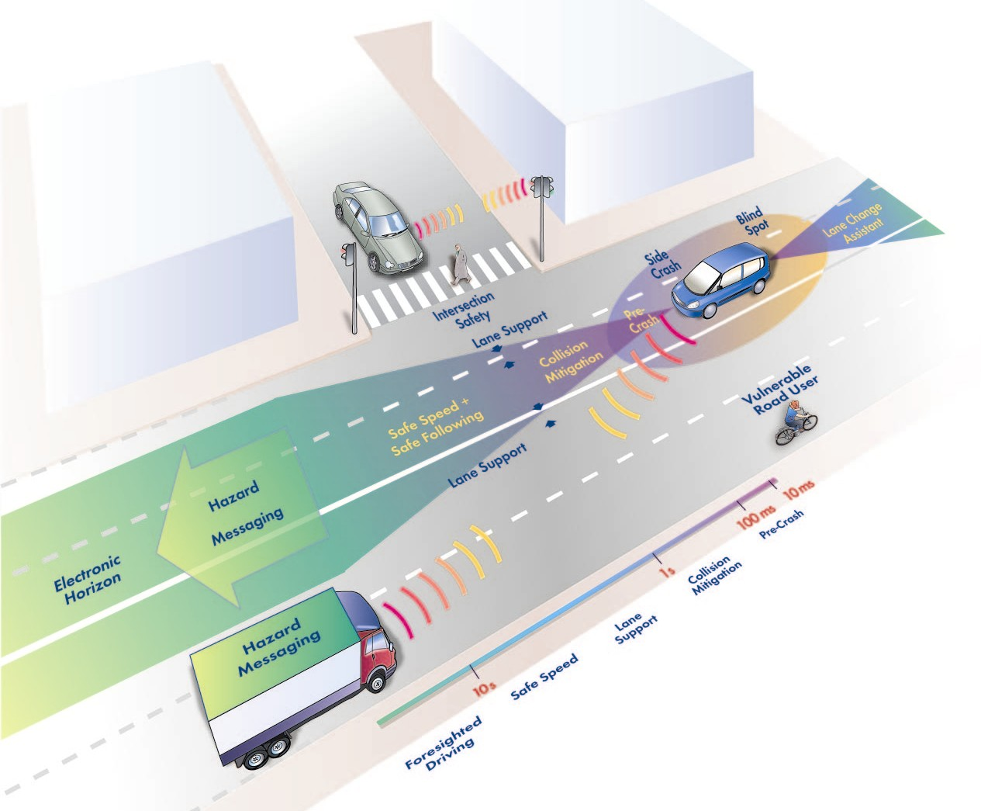
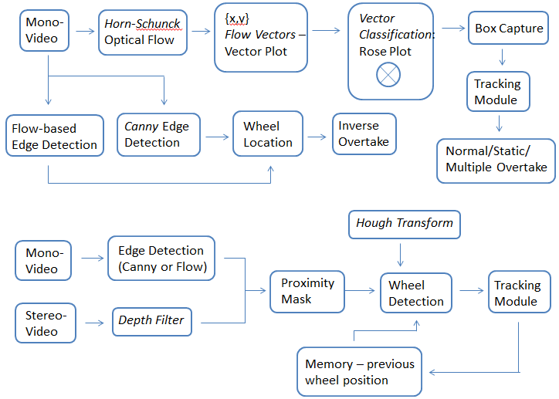
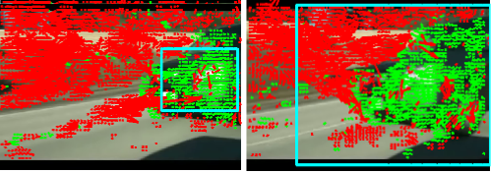
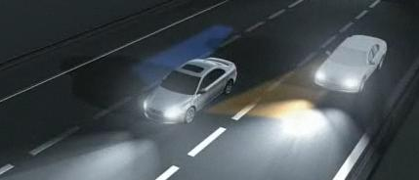
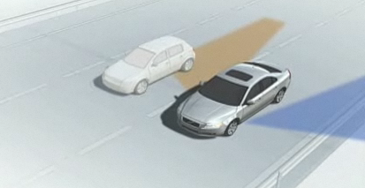
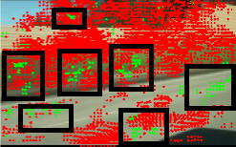
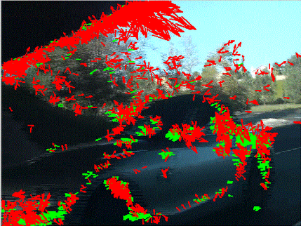
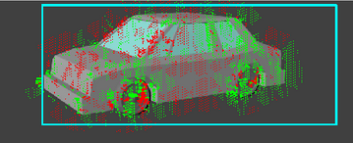
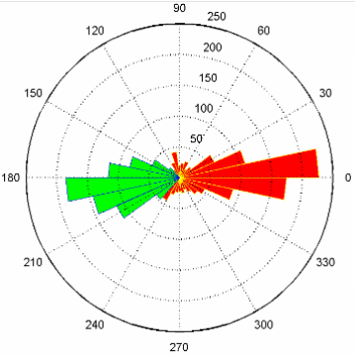
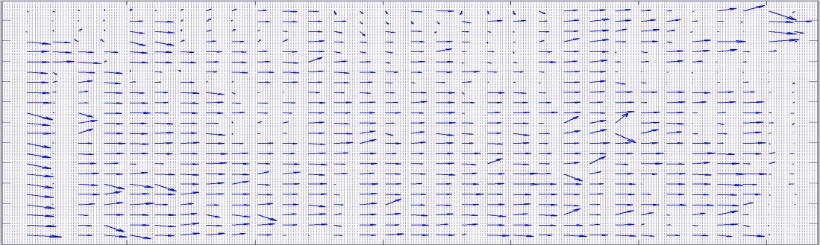
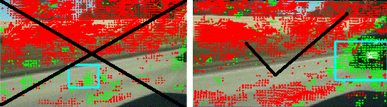
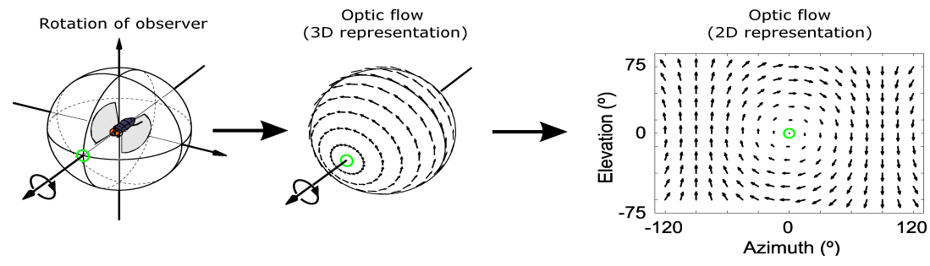
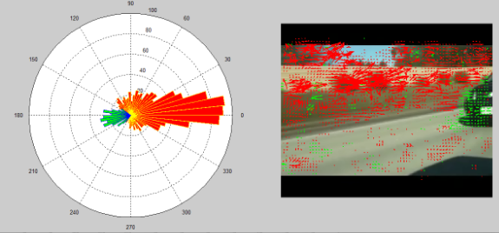
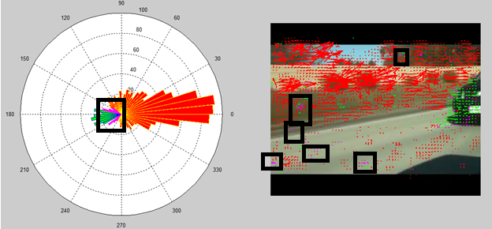
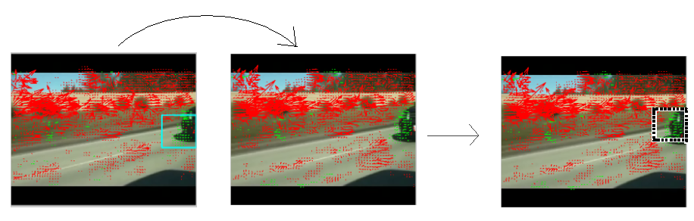
Position and Vector Detection of Blind Spot Motion with Horn-Schunck Optical Flow
Introduction
Accident Statistics:
Around 40,000 car accidents per year are due to blind spot negligence. Many drivers make lane changes and turns without safety precautions
Goals and Objectives:
Create a cost effective method of detecting motion in the blind spot
Find the position and velocity of an object of blind spot motion
Increase the efficiency of the code developed to process videos in real time to effectively alert the driver of all objects through a beeping system
Main Procedural Methods:
Obtain video recordings of objects passing the blind spot and run the video sample through a developed coding system like Matlab. The coding procedure will be based off of the Horn-Schunck optical flow with personal adjustments and advancements
Project Overview: Detailed Holistic Schematic of Coding Process
Box Capture Overview
General Definition:
The goal is to create a box that can surround the vehicle when one is present and track the vehicle throughout the frames
Box Center:
Given all of the vectors plotted on a (x,y) scale, the average of all the (x,y) coordinates of the object vectors acts as the initial center
Box Size:
The box size is directly proportional to the ratio of object to background vectors. We want a bigger box to appear as the object gets closer to fully encompass it’s increasing size.
Notice that the dimensions of the blue box enlarges as car is moving closer
Standard Deviation (SD) Filter:
The initial center is skewed by outlier vectors
Method: all vectors 3 SD away from initial center are removed and the center is recalculated
The method is repeated with 2 SD and then 1 SD for accuracy
Pictures were taken from the Volvo car demonstration. The blue and orange zones represent the right and left blind spot regions of the driving car
Data format: Vector Visual Representation with Optical Flow
The black boxes locate the computational outliers
Horn-Schunck Optical Flow and Vector Magnitude Plot Generation
Quiver Plot:
Graphs the vector arrows against the actual frame image
Most of the Optical Flow Calculations are based off of the
Quiver Plot
Notice that the simulated image has no background, because the posterior is a consistent gray
Vector Threshold:
At least 33% of all the object vectors must be located inside the box or else the box is nullified
Movement Threshold:
Look for a box with the starting point based on the position of the box in the last frame
A box must be stable for 3 frames before the threshold applies
Box Velocity:
The motion of the center of the box can be used for a speed calculation. The box center should remain relatively constant for the first 50 to 100 frames → good estimation.
Quick detection (via memory system):
If a box was detected in the last three frames, then we use the box position from the last frame as the starting point for finding the box center in the current frame
Assumes that car position in current frame does not deviate greatly from the position in the last frame.
Saves output time since the multiple standard deviation step along with the initial box detection step is skipped.
Optical Flow Explanation:
A method that can compare subsequent frames of a video to generate a vector plot of motion.
Each pixel of the first frame is pinpointed in the next frame and the movement of the pixel can be denoted by a vector arrow
Object Vectors
Rose Plot (Circular Histogram):
Graphs the vector arrows based on direction. The height of the bars correlates to frequency, not magnitude. The green bars represent object vectors, while the red bars symbolize background vectors.
Background Vectors
The threshold fixes a bad box generation.
Each pixel has a specific luminescence
Optical Flow operates via convulsion, meaning that blocks of pixels are compared at a time
Vector Differentiation:
The vector arrows are split into two categories: object (green) and background (red).
The object vectors usually designate motion while the background designate the “stationary” posterior
Angle Threshold Filter:
The object vectors were assumed to be within an angle range of π/4,
We use the Standard Deviation Filter (See Box Capture Overview) to remove outlier vectors and recalculate the angle range
Horn-Schunck Optical Flow Advantages:
Yields a high density of flow vectors → any missing vectors in homogeneous objects are made up for by its surrounding pixels
Based off of two flow vectors [u,v]. The result is minimized distortions in flow because it prefers solutions that maximize Alpha
The black boxes locate the purple vectors → the outliers that were taken out with the Angle Threshold
Horn-Schunck Optical Flow Disadvantages:
Accuracy of computation is easily decreased by noise in the system.( ie. Heat wave, Reflection of sunlight from puddle)
Significant time lag in computing the vectors.
Before
After
System Capability
(Designated Situational Assessment)
Frame 40 Frame 41 Frame 41

